Slide 1
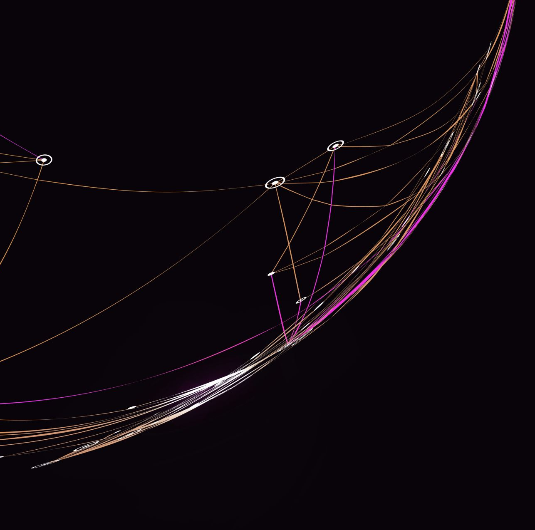
Project in Computer Programming
Sales inventory v2

Slide 2
Overview
We are tasked to implement a program that handles (a) File Management, (b) Transaction, (c) Advance Request, and (d) Generate Report. For the sake of consistency we named (b) Transaction -> Normal Transaction and (c) Advance Request -> Advance Transaction. We also added an additional feature of the program in which the transacted item will be automatically picked up when the schedule is due. We also added a daily report in which a textfile of the date’s name will accommodate its report throughout the day.

Slide 3
Running the Program
In the menu there are five options to choose from.
Entering 1 will run the function Normal Transaction. This function handles three files as its parameter.
Entering 2 will run the function Advance Transaction. This function handles three files as its parameter.
Entering 3 will run the function Generate Report.
Entering 4 will run the function File Management.

Slide 4
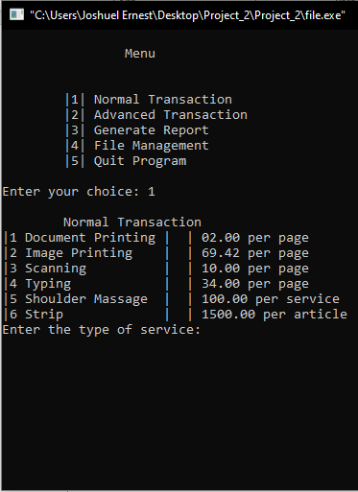
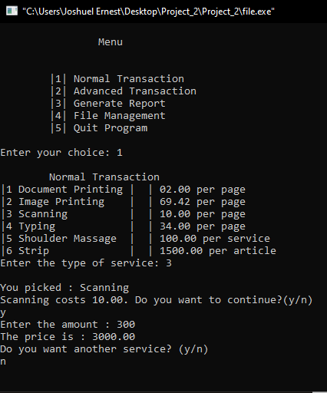
Normal Transaction
In this program the user is free to choose from the current available services. Services can be added, deleted or modified in File Management option.

Slide 5
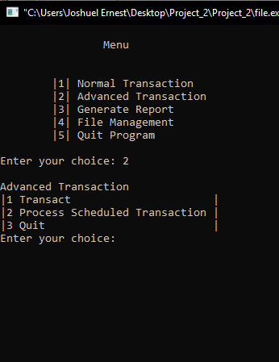
Advanced Transaction
This function of the program has two parts: The first one is the advanced transaction, and the second one is the processing/or pickup of the manually-scheduled transaction.

Slide 6
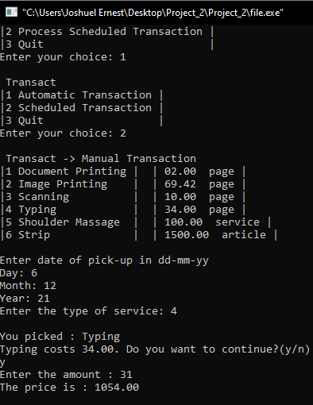
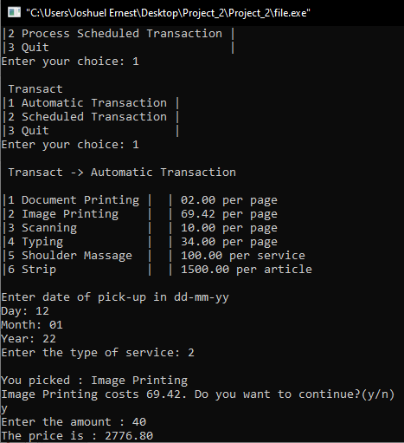
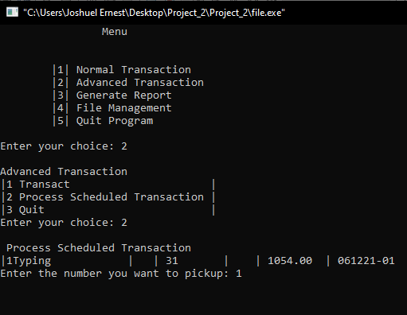
Here are some screenshots of advanced transaction:

Slide 7

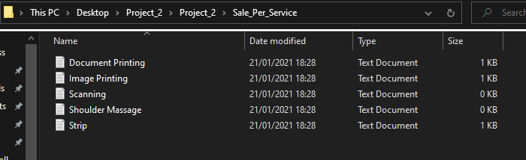
Generate Report
Generate Report can print the report and record files. It can also generate sales per service files.

Slide 8
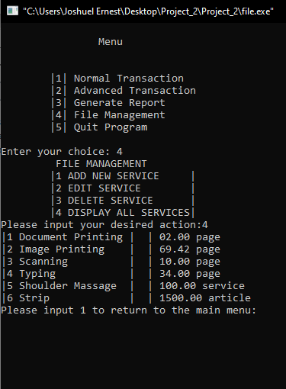
File Management
File Management can Edit the price of a service, Add and Delete a service that is shown in the Transactions options.

Slide 9
Files Related to the Program
Day Reports directory hosts the daily report files
Reference Files are files needed to run the program
Sales Per Service Directory hosts the sales per service generated by the program
Processed.txt are the items that are automatically processed by the program

Slide 10
Thank You
Programmed by: Presentation by:
Joshuel Ernest Q. Simbulan Joshuel Ernest Q. Simbulan
Andrew James S. Tejerero
Simon Daniel Dela Cruz
Gerry Neil David Sangco

